Slide 1

Basic Decision Making
Decisions by Reflex Agents

Slide 2


Agent Architecture
Filter
Knowledge
Percepts
Behavior
Actions

Slide 3
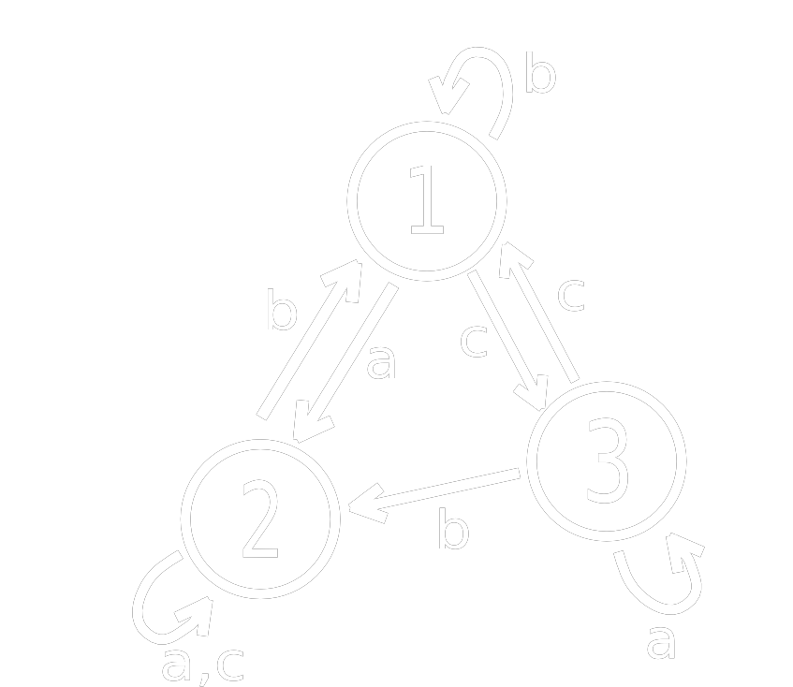
Finite State Machines
Finite State Machines
Memory is only the current state
Changes triggered by input
Begins in the start state (usually)

Slide 4
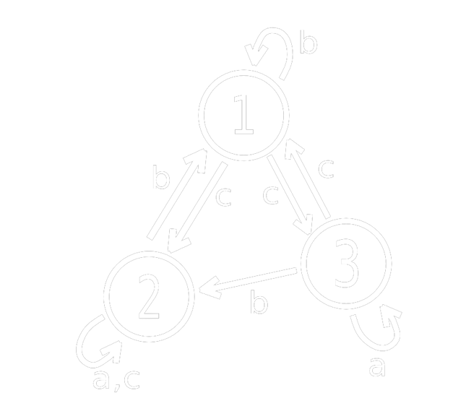
Determinism vs. Non-Determinism
Deterministic FSMs:
Are completely predictable
Have exactly one action for each input
Non-deterministic FSMs:
Are unpredictable
Can have any number of actions for an input
Are very similar to Markov chains

Slide 5

FSMs in Games
Structure
Every frame, current state runs code
In its first update, a state should initialize
In its last update, a state should have exit code
Transitions
Transitions will be stored in a transition table
Machines will accept engine events as input
Generally followed once per frame
We will attempt to make a state machine that is as generic as possible so the code can be reused.

Slide 6
Coding an FSM
class Fsm
{
list<State*> states;
State *current, *start;
int transition[#s][#i];
queue<Event*> events;
void Init();
void Update();
// Update = change state (maybe)
void Shutdown();
void EnqueueEvent(Event*);
int Transition();
// Transition = table lookup
}
class State
{
void enter();
void update();
void exit();
}

Slide 7
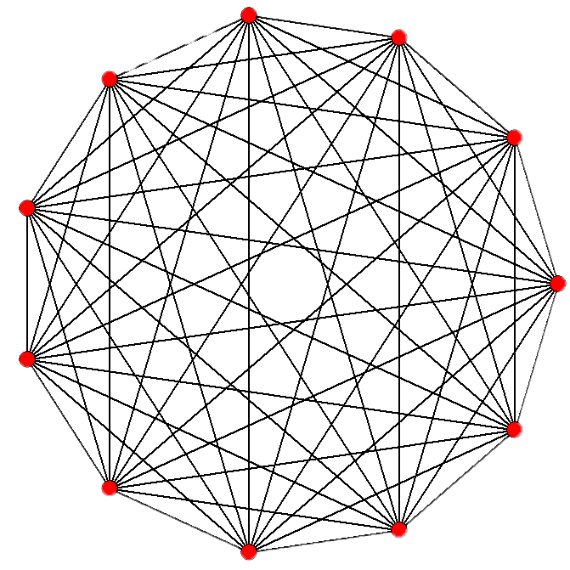
FSM Problems
Finite State Machines are easy to code and have been very successful in games, but have some problems:
  Don’t scale well (spaghetti)
  No memory of past events
  Purely reactive – no plans/goals
  Can be too predictable
Scaling can be handled to some degree with Hierarchical FSMs (HFSMs). And predictability can be addressed with probabilities, as discussed earlier – but as always, at a cost!

